Slide 1
Machine Learning Crash-Course: What is Machine Learning?

Slide 2
Before we get really into the Machine Learning stuff….

Slide 3



Who Even Am I?
3rd Year Joint Maths and Computer Science Student at Imperial College London
Coming to Brentside to teach this Machine Learning crash course as part of one of my optional modules this term. Only here for around 9 weeks, coming in once a week.
Studied at Brentside from 2014-2019. Did my GCSEs here.
Studied at Greenford from 2019-2021. Did my A-Levels there in Maths, Further Maths, Physics and Chemistry. Most of my time was spent preparing for STEP – A 3 hour entrance exam for Maths at Cambridge and Computer Science courses at Imperial.
Greenford (2019-2021)
Imperial (2021-Present)
Brentside (2014-2019)

Slide 4
General Rules and Slido
If you have a question or if something doesn’t make sense feel free to ask straight away.. I want these sessions to be as interactive as possible.
It’s important to ask as many questions as possible whenever you are unsure of something, otherwise you’ll get confused and will struggle to follow the rest.
If you feel uncomfortable asking questions in front of everyone or are slightly shy don’t worry! You can ask as many questions as you want anonymously during the lessons on slido ☺
We’ll have quizzes on slido too that everyone can join in on.. Joining instructions on the next slide…

Slide 5


Join at slido.com #2991929
ⓘ Start presenting to display the joining instructions on this slide.

Slide 6
So what exactly is Machine Learning?
A branch of AI that enables computers to learn from data and improve their performance on tasks on their own.
A Machine Learning Model can be viewed as a mathematical function that given some data, predicts a value.

Slide 7
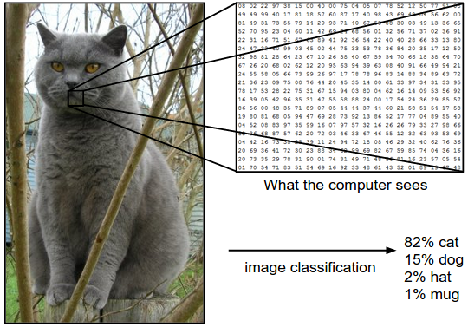
Two Main Types of Problems
Classification Problems
E.g: Is a picture a cat or not?
Discrete number of classes. (The answer will be a whole number)
For the example, class 0 = cat, class 1 = not a cat, so if a cat exists in a picture the model should return the integer (whole number) 1.
Regression Problems
E.g: Predicting the price of a house based on its features and area
The answer is continuous (so can be both whole numbers and decimals numbers over a wide range)
For the above example, we could have the model output prices such as £351,043.32 or £200,000 etc etc

Slide 8
Classification
Binary Classification
Assigning exactly 1 out of only 2 classes (choices) to an input instance
E.g: “Is this picture of a cat or not a cat?” (class 0 = cat, class 1 = not cat)
Think of it as a “yes” or “no”
Multi-Class Classification
Assigning exactly 1 out of 3 or more classes to an input instance
E.g: “Is this picture of a cat, dog, horse or another animal?” (class 0 = cat, class 1 = dog, class 2 = horse, class 3 = another animal)
Multi-Label Classification
Assigning multiple classes to an input instance
E.g: “What animals does this picture contain?” (class 0=cat, class 1 = dog, class 2 = horse, class 3 = another animal)

Slide 9
Regression
Simple Regression
Single input variable is inputted into our machine learning model. Getting a single prediction out.
Multiple Regression
Multiple input variables are inputted into our machine learning model. Getting a single prediction out.
House Size
Machine Learning Model/Algorithm
House Price Prediction
House Location
House Size
Machine Learning Model/Algorithm
House Price Prediction
Number of bedrooms

Slide 10
Different ways of Learning
Supervised Learning – Train the model with the correct labels. So model can compare its own predictions with the actual answers and improve itself during training.
Unsupervised Learning – Train the model without any labels. So model cannot compare its own predictions with the actual answers during training. This is usually used for things such as clustering (grouping data into different sub-sections) and anomaly detection
There are also quite a few others such as Reinforcement Learning but we won’t be looking at these.

Slide 11
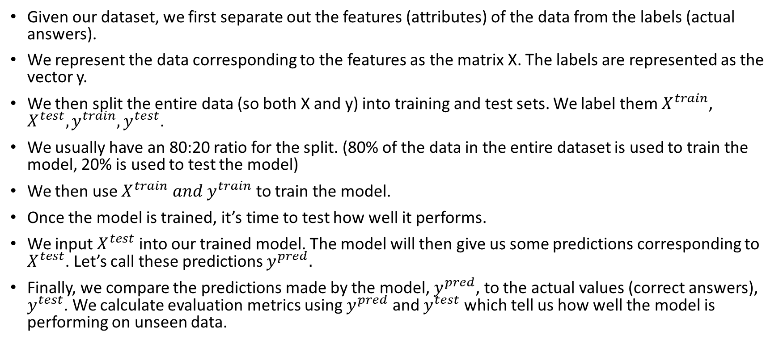
The Basic Supervised Learning Pipeline
Given our dataset, we first separate out the features (attributes) of the data from the labels (actual answers).
We represent the data corresponding to the features as the matrix X. The labels are represented as the vector y.
We then split the entire data (so both X and y) into training and test sets. We label them $X^{train}$, $X^{test}, y^{train}, y^{test}$.
We usually have an 80:20 ratio for the split. (80% of the data in the entire dataset is used to train the model, 20% is used to test the model)
We then use $X^{train} and y^{train}$ to train the model.
Once the model is trained, it’s time to test how well it performs.
We input $X^{test}$ into our trained model. The model will then give us some predictions corresponding to $X^{test}$. Let’s call these predictions $y^{pred}.$
Finally, we compare the predictions made by the model, $y^{pred}$, to the actual values (correct answers), $y^{test}$. We calculate evaluation metrics using $y^{pred}$ and $y^{test}$ which tell us how well the model is performing on unseen data.
Notes:
Draw diagram on board whilst going through this step by step. Draw what a dataset looks like too.

Slide 12
Live Coding Demo

